Slide 1


COVID-19 Preparedness Qualification

Slide 2
DISCLAIMER
This presentation/manual is intended as a supplement to actual hands-on instruction and is designed to teach one or more of the acceptable and recognized methods of performing specific tasks. It is not meant to be, nor should it be considered, an absolute or complete presentation of the procedures and safety measures that relate to these tasks.
Work processes and government safety regulations can and do change, and it is the employer’s responsibility to provide workers with the most recent technical and safety information involving these processes.
The guidelines and instructions presented here are not meant to supersede manufacturers’ instructions or contractors’ jobsite procedures, nor are they meant to replace any current local, state, provincial, or federal safety rules or regulations.

Slide 3
DISCLAIMER
It is essential that you always follow all current local, state, provincial, or federal safety rules, regulations, and guidelines whenever you perform any of these tasks.
No statements made in this manual should give the impression that the Carpenters International Training Fund or the United Brotherhood of Carpenters and Joiners of America, their affiliates, representatives, or employees have assumed any part of the employer’s legal responsibility to provide a “safe and healthful workplace,” as mandated by the Occupational Safety and Health Act of 1970.

Slide 4
COURSE OVERVIEW
The UBC/CITF recognizes that our members and signatory contractors are always committed to ensuring the health and safety of their workplace.
The Eastern Atlantic States Regional Council of Carpenters has prepared this online course to review the March 2020 guidance document from OSHA on Preparing Workplaces for COVID-19.
This online course is designed to educate our members on how to use the OSHA guidance, as well as other Jobsite Protocols to take the appropriate steps to limit the spread of the Coronavirus.

Slide 5
COURSE OVERVIEW
The Jobsite Protocols are to be viewed as recommended best practices and are provided solely as suggested guidelines and resources for contractors’ reference concerning COVID-19.
The protocols are not to be relied upon to prevent the spread or transmission of COVID-19 on any specific jobsite or to prevent a safety violation from being issued by a jurisdictional authority.
All contractors must continue to comply with all relevant rules and regulations concerning workplace safety and health. This is not legal advice.

Slide 6
COURSE OVERVIEW
This course is a distance learning course and can be completed on your computer, tablet or cell phone at your own pace.
A test is required at the end of the presentation.
You must score a 75% or higher to pass.
Since this is an informational training you may utilize multiple attempts to reach the 75%.
Once you pass your test, your Training Verification Card will show you have completed the course.

Slide 7
OSHA GUIDANCE
This guidance is not a standard or regulation, and it creates no new legal obligations.
It contains recommendations as well as descriptions of mandatory safety and health standards
The recommendations are advisory in nature, informational in content, and are intended to assist employers in providing a safe and healthful workplace.
The Occupational Safety and Health Act requires employers to comply with safety and health standards and regulations promulgated by OSHA or by a state with an OSHA-approved state plan.

Slide 8
OSHA GUIDANCE
In addition, the Act’s General Duty Clause, Section 5(a) (1), requires employers to provide their employees with a workplace free from recognized hazards likely to cause death or serious physical harm.
Material contained in this publication is in the public domain and may be reproduced, fully or partially, without permission. Source credit is requested but not required.
This information will be made available to sensory impaired individuals upon request. Voice phone: (202) 693-1999; tele typewriter (TTY) number: 1-877-889-5627.

Slide 9
INTRODUCTION
Coronavirus Disease 2019 (COVID-19) is a respiratory disease caused by the SARS-CoV-2 virus. It has spread from China to many other countries around the world, including the United States.
Depending on the severity of COVID-19’s international impacts, outbreak conditions—including those rising to the level of a pandemic—can affect all aspects of daily life, including travel, trade, tourism, food supplies, and financial markets

Slide 10
INTRODUCTION
To reduce the impact of COVID-19 outbreak conditions on businesses, workers, customers, and the public, it is important for all employers to plan now for COVID-19.
For employers who have already planned for influenza pandemics, planning for COVID-19 may involve updating plans to address the specific exposure risks, sources of exposure, routes of transmission, and other unique characteristics of SARS-CoV-2 (i.e., compared to pandemic influenza viruses.

Slide 11
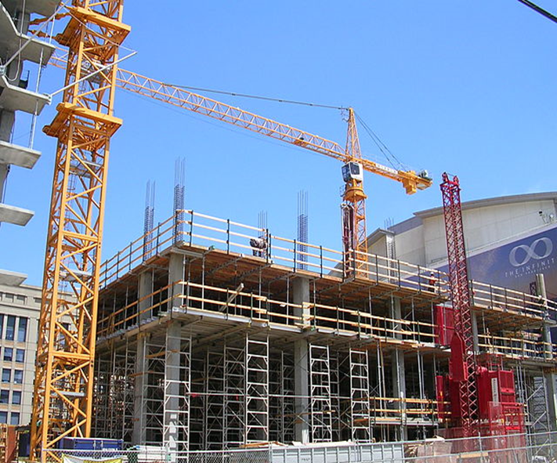
INTRODUCTION
Employers who have not prepared for pandemic events should prepare themselves and their workers as far in advance as possible of potentially worsening outbreak conditions.
Lack of continuity planning can result in a cascade of failures as employers attempt to address challenges of COVID-19 with insufficient resources and workers who might not be adequately trained for jobs they may have to perform under pandemic conditions.

Slide 12

INTRODUCTION
The Occupational Safety and Health Administration (OSHA) developed this COVID-19 planning guidance based on traditional infection prevention and industrial hygiene practices.
It focuses on the need for employers to implement engineering, administrative, and work practice controls and personal protective equipment (PPE), as well as considerations for doing so.

Slide 13

INTRODUCTION
This guidance is intended for planning purposes.
Employers and workers should use this planning guidance to help identify risk levels in workplace settings and to determine any appropriate control measures to implement.
Additional guidance may be needed as COVID-19 outbreak conditions change, including as new information about the virus, its transmission, and impacts, becomes available.

Slide 14

INTRODUCTION
The U.S. Department of Health and Human Services’ Centers for Disease Control and Prevention (CDC) provides the latest information about COVID-19 and the global outbreak:
https://www.cdc.gov/coronavirus/2019-ncov/index.html
The OSHA COVID-19 webpage offers information specifically for workers and employers:
https://www.osha.gov/SLTC/covid-19/

Slide 15

ABOUT COVID-19
Symptoms of COVID-19
Infection with SARS-CoV-2, the virus that causes COVID-19, can cause illness ranging from mild to severe and, in some cases, can be fatal. Symptoms typically include fever, cough, and shortness of breath
Some people infected with the virus have reported experiencing other non-respiratory symptoms. Other people, referred to as asymptomatic cases, have experienced no symptoms at all.
According to the CDC, symptoms of COVID-19 may appear in as few as 2 days or as long as 14 days after exposure

Slide 16
ABOUT COVID-19
How COVID-19 Spreads
Although the first human cases of COVID-19 likely resulted from exposure to infected animals, infected people can spread SARS-CoV-2 to other people
The virus is thought to spread mainly from person to-person, including:
  Between people who are in close contact with one another (within about 6 feet).
  Through respiratory droplets produced when an infected person coughs or sneezes. These droplets can land in the mouths or noses of people who are nearby or possibly be inhaled into the lungs

Slide 17
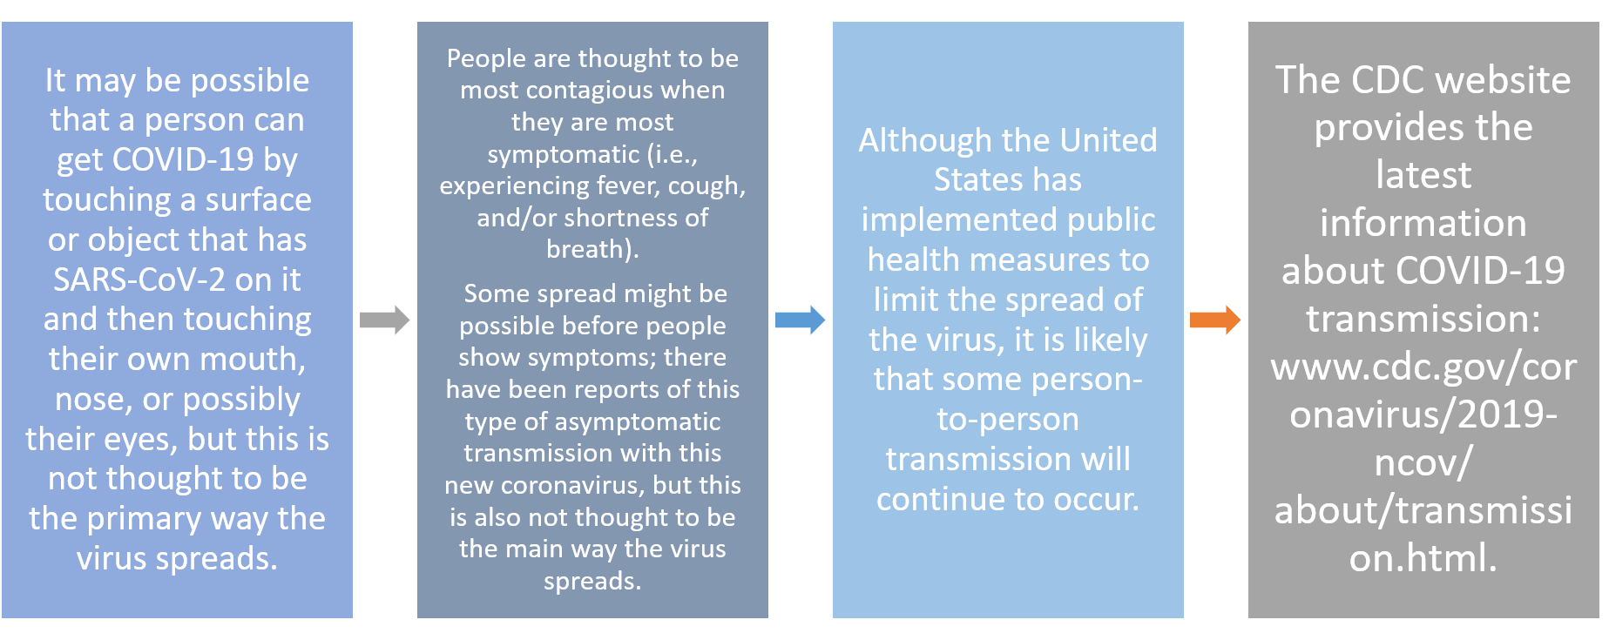
ABOUT COVID-19

Slide 18
HOW A COVID-19 OUTBREAK COULD AFFECT WORKPLACES ?
Like influenza viruses, SARS-CoV-2, the virus that causes COVID-19, has the potential to cause extensive outbreaks. Under conditions associated with widespread person-to-person spread, multiple areas of the United States and other countries may see impacts at the same time. In the absence of a vaccine, an outbreak may also be an extended event.

Slide 19
HOW A COVID-19 OUTBREAK COULD AFFECT WORKPLACES ?
As a result, workplaces may experience 3 new challenges:
1. Absenteeism
Workers could be absent because they are sick; are caregivers for sick family members; are caregivers for children if schools or day care centers are closed; have at-risk people at home, such as immunocompromised family members; or are afraid to come to work because of fear of possible exposure.
2. Change in patterns of commerce
Consumer demand for items related to infection prevention (e.g., respirators) is likely to increase significantly, while consumer interest in other goods may decline. Consumers may also change shopping patterns because of a COVID-19 outbreak. Consumers may try to shop at off-peak hours to reduce contact with other people, show increased interest in home delivery services, or prefer other options, such as drive through service, to reduce person-to-person contact.
3. Interrupted supply/delivery
Shipments of items from geographic areas severely affected by COVID-19 may be delayed or cancelled with or without notification

Slide 20

Steps All Employers Can Take to Reduce Workers Risks of Exposure to SARS-CoV-2
Develop
Develop an Infectious Disease Preparedness and Response Plan
Prepare
Prepare to Implement Basic Infection Prevention Measures
Policy & Procedures
Develop Policies and Procedures for Prompt Identification and Isolation of Sick People, if Appropriate
Implement & Communicate
Develop, Implement, and Communicate about Workplace Flexibilities and Protections
Implement Workplace Controls
Follow
Follow Existing OSHA Standards
Controls

Slide 21
CLASSIFYING WORKER EXPOSURE TO SARS-CoV-2
Worker risk of occupational exposure to SARS-CoV-2, the virus that causes COVID-19, during an outbreak may vary from very high to high, medium, or lower (caution) risk.
The level of risk depends in part on the industry type, need for contact within 6 feet of people known to be, or suspected of being, infected with SARS-CoV-2, or requirement for repeated or extended contact with persons known to be, or suspected of being, infected with SARS-CoV-2.
To help employers determine appropriate precautions, OSHA has divided job tasks into four risk exposure levels: very high, high, medium, and lower risk.

Slide 22
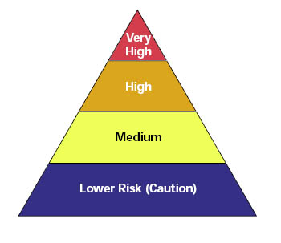
CLASSIFYING WORKER EXPOSURE TO SARS-CoV-2
The Occupational Risk Pyramid shows the four exposure risk levels in the shape of a pyramid to represent probable distribution of risk.
Most American workers will likely fall in the lower exposure risk (caution) or medium exposure risk levels.

Slide 23
CLASSIFYING WORKER EXPOSURE TO SARS-CoV-2
Very High Exposure Risk
Very high exposure risk jobs are those with high potential for exposure to known or suspected sources of COVID-19 during specific medical, postmortem, or laboratory procedures.
Workers in this category include:
Healthcare workers performing aerosol-generating procedures on known or suspected COVID-19 patients
Healthcare or laboratory personnel collecting or handling specimens from known or suspected COVID-19 patients
Morgue workers performing autopsies, which generally involve aerosol-generating procedures, on the bodies of people who are known to have, or suspected of having, COVID-19 at the time of their death

Slide 24
CLASSIFYING WORKER EXPOSURE TO SARS-CoV-2
High Exposure Risk
High exposure risk jobs are those with high potential for exposure to known or suspected sources of COVID-19. Workers in this category include: Workers in this category include:
Healthcare delivery and support staff who must enter patient rooms who are known or suspected COVID-19 patients
Medical transport workers from known or suspected COVID-19 patients
Mortuary workers involved in preparing (e.g., for burial or cremation) the bodies of people who are known to have, or suspected of having, COVID-19 at the time of their death.

Slide 25
CLASSIFYING WORKER EXPOSURE TO SARS-CoV-2
Medium Exposure Risk
Medium exposure risk jobs include those that require frequent and/or close contact with (i.e., within 6 feet of) people who may be infected with SARS-CoV-2, but who are not known or suspected COVID-19 patients.
In areas without ongoing community transmission, workers in this risk group may have frequent contact with travelers who may return from international locations with widespread COVID-19 transmission.
In areas where there is ongoing community transmission, workers in this category may have contact with the general public (e.g., schools, high-population-density work environments, some high-volume retail settings).

Slide 26
CLASSIFYING WORKER EXPOSURE TO SARS-CoV-2
Lower Exposure Risk (Caution)
Lower exposure risk (caution) jobs are those that do not require contact with people known to be, or suspected of being, infected with SARS-CoV-2 nor frequent close contact with (i.e., within 6 feet of) the general public.
Workers in this category have minimal occupational contact with the public and other coworkers.

Slide 27

COVID-19
SIX RECOMMENDED JOBSITE PROTOCOLS
By: General Building Contractors Association of Philadelphia
&
Eastern Atlantic States Regional Council

Slide 28
PROTOCOL #1
WORKER PERSONAL RESPONSIBILITIES
Employees need to take steps to protect themselves. Refer to CDC guidelines on How to Protect Yourself.
It is critical that individuals NOT report to work while they are experiencing illness symptoms such as fever of 100.4 or higher (or local jurisdiction), cough, shortness of breath or difficulty breathing, dry cough, body aches, chills, or fatigue, or loss of sense of smell and/or taste. Refer to CDC guidelines on What To Do If You Are Sick.
  Workers should NOT return to work until at least 3 days (72 hours) have passed since recovery defined as resolution of fever without the use of fever-reducing medications and improvement in respiratory symptoms (e.g., cough, shortness of breath); and,
  At least 7 days have passed since symptoms first appeared

Slide 29
PROTOCOL #1
WORKER PERSONAL RESPONSIBILITIES
Individuals should seek medical attention if they develop these symptoms. Refer to CDC guidelines on What To Do If You Are Sick.
An individual contractor may require, in order to return to work after experiencing any of these symptoms, personnel must produce a doctor’s note or a negative COVID-19 test result.
If you feel sick, uncomfortable, or unsafe, please stay home.

Slide 30
PROTOCOL #2
SOCIAL DISTANCING
Work in occupied areas should be limited to only those tasks that are strictly necessary.
Limit physical contact with others.
Direct employees to increase personal space (to at least 6 feet, where possible).
Limit in-person meetings and replace them with phone or online meetings.
Take breaks and lunch in shifts to reduce the size of the group in the lunch area at any one time to less than 10 people, ultimately maintaining 6 feet distance between individuals.
Subcontractor foremen and project managers should communicate with their general contractors about prohibiting large gatherings (currently no more than 10 people) on the jobsite, such as the all-hands meeting and all-hands lunches.

Slide 31
PROTOCOL #2
SOCIAL DISTANCING
To limit the number of people on a jobsite, allow non-essential personnel to work from home when possible.
Avoid trade stacking, evaluate work schedule and consider things like shift work, resequencing work, etc.
Discourage hand-shaking and other contact greetings.
Social distancing should be used in hoists/elevators. Social distancing signage should be placed in all areas, hoists, elevators, stairs, and meetings areas. Individuals should be encouraged to avoid hoists/elevators when walking up or down 5 flights of stairs to limit contact with others. Depending on the size, hoists/elevators should be limited to 5 people or less when possible. Separate materials and people when possible.

Slide 32
PROTOCOL #3
GENERAL JOBSITE/ OFFICE PRACTICES
Employers should reference the CDC’s Interim Guidance for Businesses and Employers. https://www.cdc.gov/coronavirus/2019-ncov/community/guidance-business-response.html Employers should check CDC recommendations frequently and update JHAs and safety plans accordingly.
A single point of contact should be identified by the General Contractor/Construction Manager for the implementation of all COVID-19 guidance.
This individual will be responsible for implementation of ALL COVID-19 Recommended Jobsite Protocols.

Slide 33
PROTOCOL #3
GENERAL JOBSITE/ OFFICE PRACTICES
Employers should consider designating a representative to monitor for signs of illness in the workplace, and if someone is showing symptoms, ask them to leave. They should NOT be allowed to enter any occupied area before leaving.
Employers should consider designating a trained and qualified professional (i.e. EMTs, nurses, paramedics, etc.) to take employees’ temperatures with a digital, non-contact, medical grade thermometer. If a contact thermometer is needed, it must be properly disinfected between uses.
Note that some people with COVID-19 may not have a fever, so this should not be the only means of detection.

Slide 34
PROTOCOL #3
GENERAL JOBSITE/ OFFICE PRACTICES
If an employee is well but someone in their immediate household is diagnosed with COVID-19, they should notify their supervisor. Refer to CDC guidance for How To Conduct a Risk Assessment
If an employee is confirmed to have COVID-19, inform fellow employees of possible exposure to COVID-19 in the workplace, but maintain confidentiality as required by the Americans with Disabilities Act (ADA).
Ask the affected employee to identify those other employees whom he/she encountered before the employee departs.
Employees who worked in proximity (3- to 6- feet) to coworker with confirmed COVID-19 should also be sent home and referred to CDC guidance for How to Conduct a Risk Assessment

Slide 35
PROTOCOL #3
GENERAL JOBSITE/ OFFICE PRACTICES
Attendance at safety meetings should be communicated verbally and the foreman/superintendent will sign in each attendee.
Contractors should not pass around a sign-in sheet or mobile device (iPad, tablet, or mobile phone) to confirm attendance. iPad and mobile device use should be limited to a single user.
Communicate key CDC recommendations (and post signage where appropriate) to your staff and tradespeople:
  How to Protect Yourself
  If You are Sick
  COVID-19 Frequently Asked Questions
Place posters that encourage staying home when sick, cough and sneeze etiquette, and hand hygiene at the entrance to your workplace and in other workplace areas where they are likely to be seen.

Slide 36
PROTOCOL #3
GENERAL JOBSITE/ OFFICE PRACTICES
Workers will be required to answer questions related to personal health conditions.
Additionally, personnel may be temperature scanned daily prior to accessing a project by a trained and qualified professional in the safe use and interpretation of thermometers (i.e. EMTs, nurses, paramedics, etc.).
Temperature scanning may continue for the foreseeable future.
a. Screening Question Process - Greet the person and state: “As a precaution and in an effort to help prevent the spread of COVID-19 we are conducting a pre-entry screening.” Supervisors should ask the following questions to all employees prior to entering the jobsite. If they answer “yes” to any, they should be asked to leave the jobsite immediately.
It is at an individual contractor’s discretion to ask additional screening questions.

Slide 37
PROTOCOL #3
GENERAL JOBSITE/ OFFICE PRACTICES
SCREENING QUESTION PROCESS
Have you, or anyone in your household, been in close contact with a person that has tested positive for COVID-19?
Have you, or anyone in your household, been in close contact with a person that is in the process of being tested for COVID-19?
Have you been medically directed to self-quarantine due to possible exposure to COVID-19?
Are you having trouble breathing or have you had flu-like symptoms within the past 48 hours, including: fever, cough, shortness of breath, sore throat, body aches, chills, or fatigue?

Slide 38
PROTOCOL #3
GENERAL JOBSITE/ OFFICE PRACTICES
TEMPERATURE SCANNING
If required by site and if “no” to all questions: Step in and extend arm to get reading, then step away to show the results. If over 100.4, they cannot enter the site. Refer to them to your site contact. (NOTE: Follow host/owner rules. Follow thermometer instructions and recognize precision of reading range.)
Anyone asked to leave should NOT return to work until at least 3 days (72 hours) have passed since recovery defined as resolution of fever without the use of fever-reducing medications and improvement in respiratory symptoms (e.g., cough, shortness of breath); And, at least 7 days have passed since symptoms first appeared.
An individual contractor may require, in order to return to work after experiencing any of these symptoms, personnel to produce a doctor’s note or a negative COVID-19 test result.
Do not congregate in lunch areas, and wipe all common areas with appropriate disinfectant.
Do not share tools. When sharing is necessary, wipe down with proper disinfectant first.

Slide 39
PROTOCOL #4
SANITATION AND CLEANLINESS
Promote frequent and thorough hand washing with soap and running water for at least 20 seconds.
Hand washing stations are recommended to help prevent the spread of COVID-19.
Employers should also provide hand sanitizer when hand washing facilities are not available. Refer to CDC guideline for When and How to Wash Your Hands. Hand washing stations or hand sanitizer should be provided at all access points, hoists, elevators, restrooms, etc.
  All workers should wash hands often, especially before eating, smoking, or drinking, and after blowing your nose, coughing, or sneezing. Workers should refrain from touching their face.
  All sites should have hand washing stations readily available to all workers on site. If you have a large site, get a hand washing station from your portable job site toilet provider.
Providing hand sanitizer is acceptable in the interim between availability of hand washing facilities

Slide 40
PROTOCOL #4
SANITATION AND CLEANLINESS
Disinfect frequently touched surfaces within the workplace multiple times each day. Refer to CDC guideline for Clean & Disinfect.
  Disinfectant wipes should be available and used to wipe down any surfaces (doorknobs, keyboards, remote controls, desks) that are commonly touched periodically each day.
  Portable jobsite toilets should be properly cleaned by leasing company at least twice per week, when possible.
  Double check that hand sanitizer dispensers are filled. Frequently touched items (i.e., door pulls and toilet seats) should be cleaned frequently.
  Jobsite offices/trailers and break/lunchrooms should be cleaned at least twice per day.
  Employees performing cleaning will be issue proper PPE, such as nitrile gloves and eye or face protection as needed.
  Maintain Safety Data Sheets (SDS) of all disinfectants on site.
  Follow the CDC guidelines on use and types of disinfectants.

Slide 41
PROTOCOL #4
SANITATION AND CLEANLINESS
Employers should encourage employees to cover their noses and mouths with a tissue (or elbow or shoulder if a tissue is not available) when coughing or sneezing.
Wash your hands after each time you cough, sneeze, or blow your nose, and any time before touching your face or food. Refer to CDC guideline for Coughing & Sneezing.
Do not use a common water cooler. Provide individual water bottles or instruct workers to bring their own.
Instruct workers to change work clothes prior to arriving home; and to wash clothes in hot water with soap.
Utilize disposable hand towels and no-touch trash receptacles.
Avoid cleaning techniques, such as using pressurized air or water sprays that may result in the generation of bioaerosols.

Slide 42
PROTOCOL #5
PERSONAL PROTECTIVE EQUIPMENT (PPE)
Gloves: Gloves are recognized as a means of possibly preventing contact spread. The type of glove worn should be appropriate to the task. If gloves are not typically required for the task, then any type of glove it acceptable.
Eye protection: Eye protection may be a means of preventing exposure and should be worn at all times.
The CDC is currently not recommending that healthy people wear face masks.
On March 17, 2020, the government asked all construction companies to donate N95 masks to local hospitals and forego future orders for the time being. Contractors should continue to provide and direct employees to wear face masks if required by the work.
  For tasks performed within 6 feet of another person, should consider additional respiratory protection. Please consult a professional for respiratory protection guidance.
Do not share personal protection equipment (PPE).
Sanitize reusable PPE per manufacturer’s recommendation prior to each use.

Slide 43
PROTOCOL #6
JOBSITE VISTORS
Restrict the number of visitors to the jobsite, including the trailer or office.
All visitors, deliveries and delivery personnel are subject to the same criteria and guidelines as regular onsite personnel to access the jobsite: including social distancing, hand washing, temperature scanning when applicable, and health questions.
Using the same questions as field personnel recognized above under Protocol #3 General Jobsite/Office Practices

Slide 44
OTHER USEFUL RESOURCES
GBCA & EASRCC
  Job Site Protocol
CDC
  Coronavirus (COVID-19)
  Interim Guidance for Businesses and Employers –
OSHA
  OSHA Guidance on Preparing Workplaces for COVID-19
  OSHA COVID-19 FACT SHEET
WHO
  Rolling Updates on Coronavirus disease (COVID-19)
AGC of America
  Proactive Measures for Addressing COVID-19
NIOSH
  Coronavirus Disease-2019

Slide 45
THANK YOU!

